Slide 1

Introduction to Bootstrap Layout và JavaScript Components

Slide 2
Objectives
Identify the purpose of using front-end UI frameworks in web design and development
Set up and Configure project with Bootstrap
Use the Bootstrap grid system to design responsive websites
Recognize how the JavaScript components provide dynamic behavior
Create various navigational elements using Tabs and Accordion
Create modals, tooltips and popovers to reveal content in your website
Build a carousel to show dynamic content on your website

Slide 3
Front-End Web UI Frameworks

Slide 4
What are front-end UI frameworks?
Collection of ready-to-use HTML, CSS and JavaScript templates for UI components:
Typography, Forms, Buttons, Tables, Navigations, Dropdowns, Alerts, Modals, Tabs, Accordion, Carousel etc.

Slide 5
Popular front-end UI frameworks
Bootstrap
Semantic-UI
Foundation
Materialize
Material UI
Pure
Skeleton
UIKit
Milligram
Susy

Slide 6
Why Front-End Web UI Frameworks?
Responsive web design
Mobile first
Cross-browser compatibility
Dealing with quirks of browsers
Increased productivity
Easy to get started
Community support
Resources and web page templates

Slide 7
Introduction to Bootstrap

Slide 8
Bootstrap Overview
Bootstrap is the most popular HTML, CSS, and JS framework for developing responsive, mobile first projects on the web
From the Bootstrap webpage
Front-end framework for faster and easier web development
Includes HTML and CSS based design templates for typography, forms, buttons, tables, navigation, modals, image carousels and many other, as well as optional JavaScript plugins
Easily create responsive designs with mobile first approach

Slide 9
Bootstrap History
First released in 2011
Mark Otto and Jacob Thornton
Current Production Version 5.3
The first comprehensive framework
Gained popularity very quickly

Slide 10
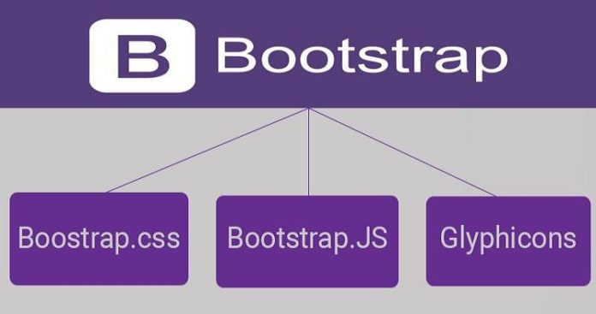
Bootstrap files

Slide 11
Viewport
<meta name="viewport" content="width=device-width, initial-scale=1">
The viewport meta tag:
Ensures that the screen width is set to the device width and the content is rendered with this width in mind
Designing the websites to be responsive to the size of the viewport
Bootstrap grid system
https://getbootstrap.com/docs/5.3/layout/grid/

Slide 12
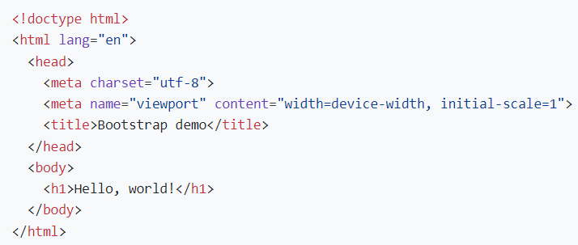
Using BootStrap by CDN
Create a new index.html file in your project root.
Include Bootstrap’s CSS and JS
CDN links: Place the <link> tag in the <head> for our CSS, and the <script> tag for our JavaScript bundle
<link href="https://cdn.jsdelivr.net/npm/bootstrap@5.3.1/dist/css/bootstrap.min.css" rel="stylesheet">
<script src="https://cdn.jsdelivr.net/npm/bootstrap@5.3.1/dist/js/bootstrap.bundle.min.js"></script>
Including Popper for positioning dropdowns, poppers, and tooltips
<script src="https://cdn.jsdelivr.net/npm/@popperjs/core@2.11.8/dist/umd/popper.min.js"></script>
<script src="https://cdn.jsdelivr.net/npm/bootstrap@5.3.1/dist/js/bootstrap.min.js"></script>
https://getbootstrap.com/docs/5.3/getting-started/introduction/

Slide 13
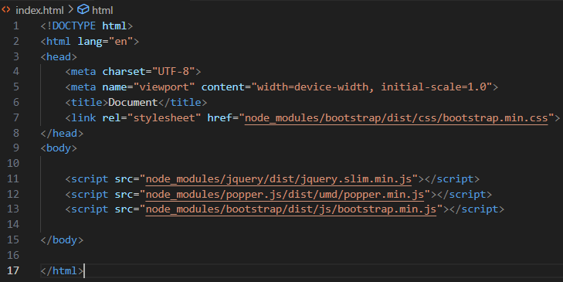

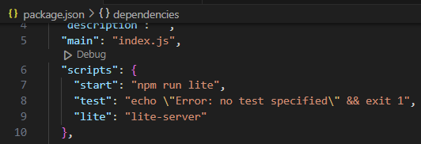
Using BootStrap by Terminal
Create a folder to hold the files.
Initialize a new npm project:
Run the command "npm init -y" to initialize.
Install Bootstrap package.
Create an HTML file: index.html
Inside the index.html file, add the following code to include the Bootstrap CSS and JavaScript files
Start a local development server to view your project:
npx lite-server

Slide 14
Exercise 5: Getting Started with Bootstrap

Slide 15
Bootstrap Grid
Designed to be:
Responsive
Mobile first
Fluid

Slide 16
CSS Flexbox Layout
Simpler and flexible layout options in CSS
Can easily handle dynamic/unknown size of content containers
Direction-agnostic layout

Slide 17
Why Flexbox for Bootstrap?
Easy vertical alignment of content within a parent element
Easy reordering of content across devices and screen resolutions with the help of media queries
Easy CSS-only equal height columns for your grid-based layouts

Slide 18
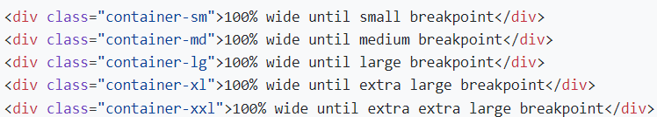
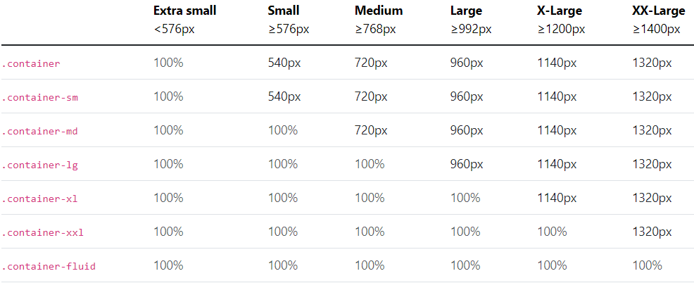


Bootstrap Container
Bootstrap comes with three different containers:
.container, which sets a max-width at each responsive breakpoint
.container-{breakpoint}, which is width: 100% until the specified breakpoint
.container-fluid, which is width: 100% at all breakpoints

Slide 19
Boostrap Grid

Slide 20
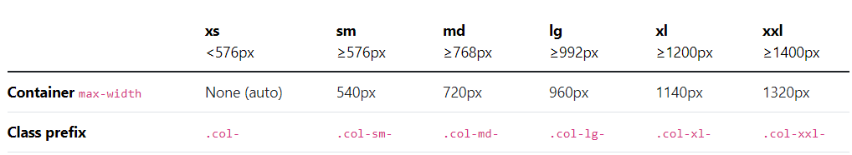
Bootstrap Grid
Bootstrap’s grid system can adapt across all six default breakpoints, and any breakpoints you customize. The six default grid tiers are as follows:
Extra small (xs)
Small (sm)
Medium (md)
Large (lg)
Extra large (xl)
Extra extra large (xxl)

Slide 21
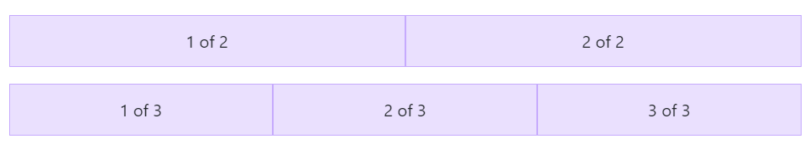
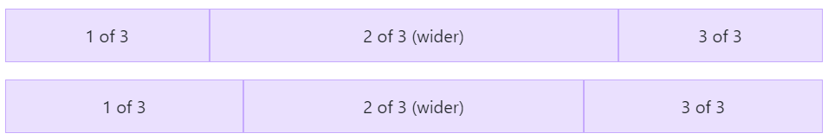
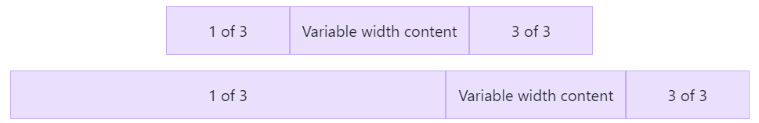
Auto-layout columns
Equal-width
Add any number of unit-less classes for each breakpoint
Setting one column width
Auto-layout for flexbox grid columns
Variable width content
Use col-{breakpoint}-auto classes to size columns based on the natural
https://getbootstrap.com/docs/5.3/layout/grid/#auto-layout-columns

Slide 22
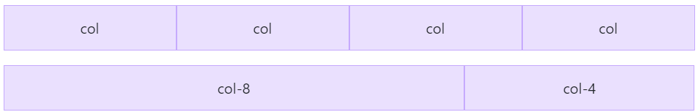
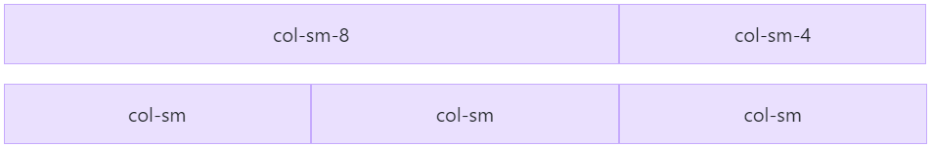
Responsive classes
All breakpoints
use the .col and .col-* classes
Stacked to horizontal
Using a single set of .col-sm-* classes
https://getbootstrap.com/docs/5.3/layout/grid/#responsive-classes

Slide 23
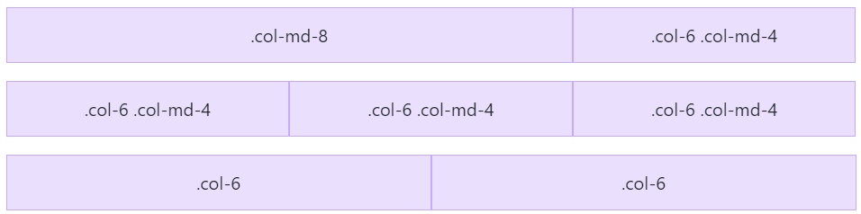

Responsive classes – cont’d
Mix and match
Use a combination of different classes for each tier as needed
Row columns Use the responsive .row-cols-*
https://getbootstrap.com/docs/5.3/layout/grid/#responsive-classes

Slide 24
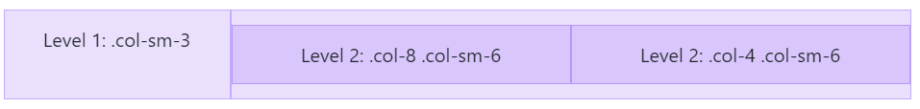
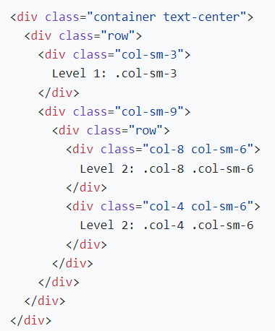
Nesting column
To nest content with the default grid, add a new .row and set of .col-sm-* columns within an existing .col-sm-* column.

Slide 25
Bootstrap Column

Slide 26
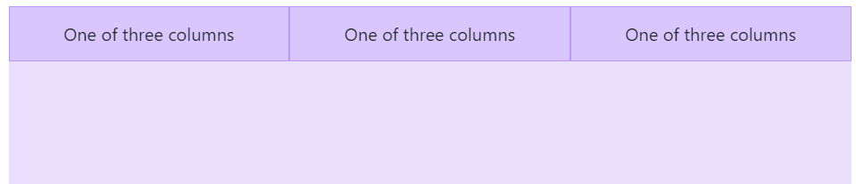
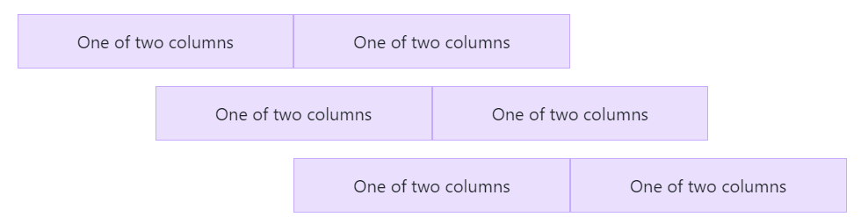
Flexbox Alignment
Vertical alignment
Change the vertical alignment with any of the responsive align-items-* classes
Horizontal alignment
Change the horizontal alignment with any of the responsive justify-content-* classes.
Notes:
https://getbootstrap.com/docs/5.3/layout/columns/#alignment

Slide 27
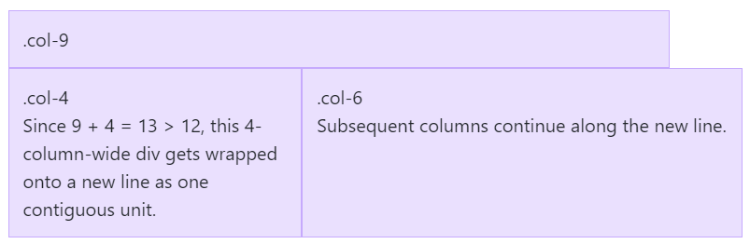
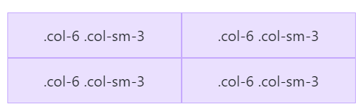
Flexbox Alignment – cont’d
Column wrapping
If more than 12 columns are placed within a single row, each group of extra columns will, as one unit, wrap onto a new line
Column breaks
Breaking columns to a new line in flexbox requires a small hack: add an element with width: 100% wherever you want to wrap your columns to a new line
Notes:
https://getbootstrap.com/docs/5.3/layout/columns/#alignment

Slide 28
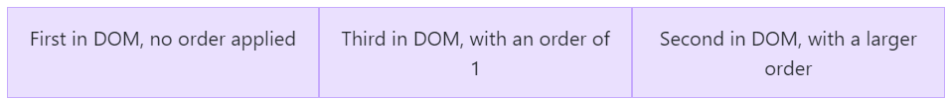
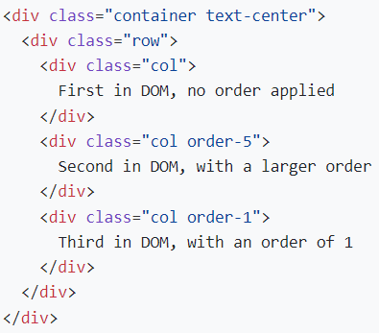
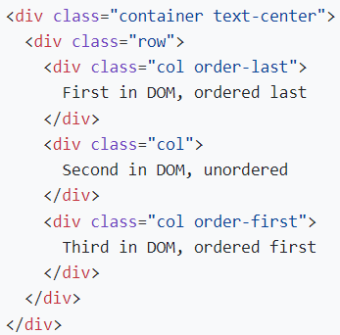
Reordering
Order classes
Use .order- classes for controlling the visual order of your content. These classes are responsive, so you can set the order by breakpoint (e.g., .order-1.order-md-2).

Slide 29
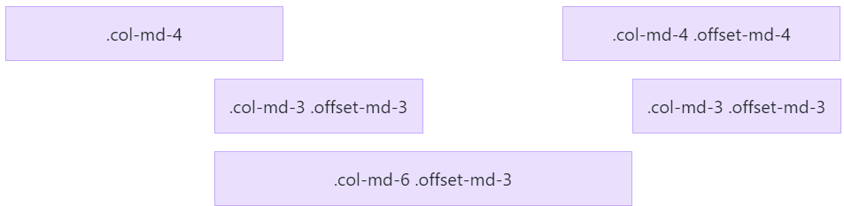
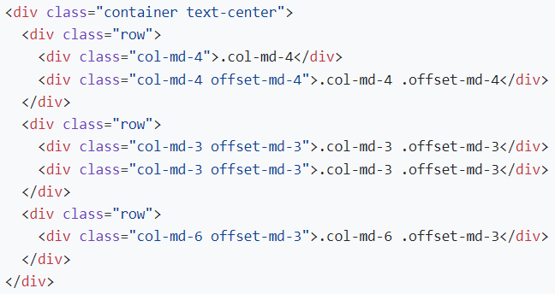
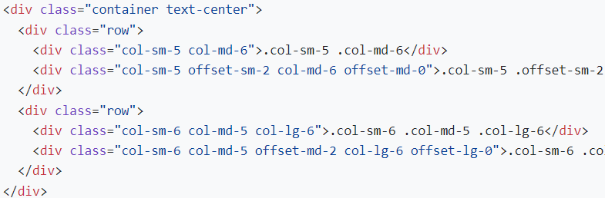
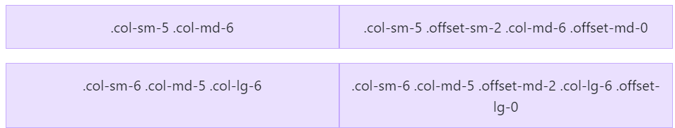
Reordering – cont’d
Offset classes
Move columns to the right using .offset-md-* classes. These classes increase the left margin of a column by * columns.
Notes:
Offsetting columns
You can offset grid columns in two ways: our responsive .offset- grid classes and our margin utilities. Grid classes are sized to match columns while margins are more useful for quick layouts where the width of the offset is variable.

Slide 30
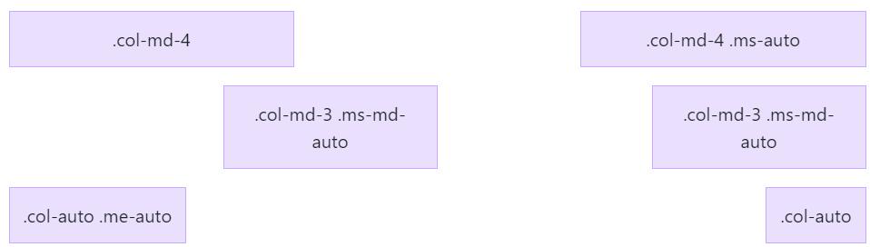
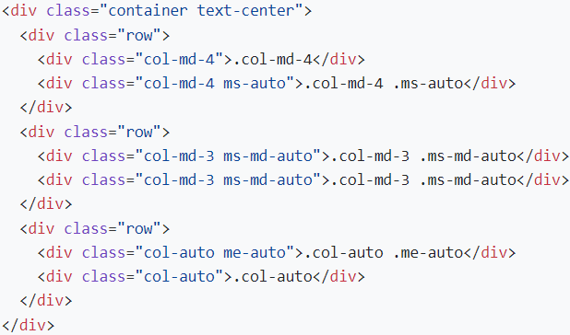
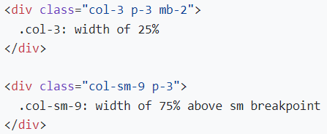
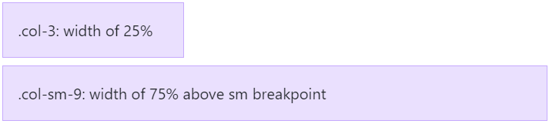
Reordering – cont’d
Margin utilities
With the move to flexbox in v4, you can use margin utilities like .me-auto to force sibling columns away from one another.

Slide 31
Exercise 6: Build website layout using Bootstrap Grid

Slide 33
Bootstrap JavaScript Components

Slide 34
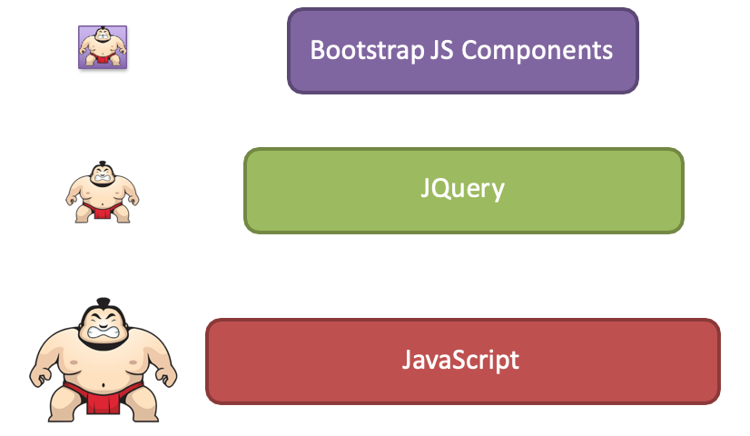
Bootstrap and JavaScript
Bootstrap’s JavaScript support is through JS Plugins
Plugins written based on Jquery
Plugins can be individually included

Slide 35
Bootstrap JS Components
JS components can all be used without writing a single line of JavaScript:
data-* attributes (e.g., data-toggle, data-spy)
Straightforward approach to use plugins
We will explore this approach in this module
Full JS API available if needed
Need to know JQuery syntax and JavaScript

Slide 36


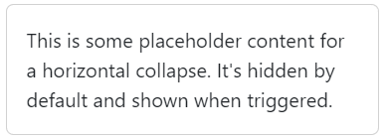
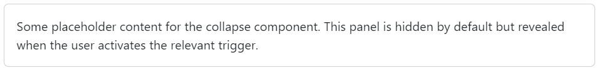
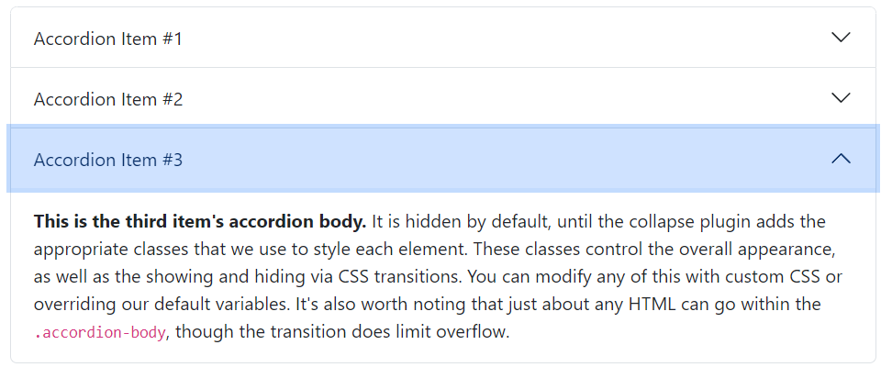
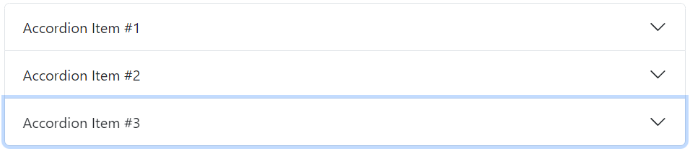
Collapse and Accordion
Collapse: Toggle the visibility of content across your project with a few classes and our JavaScript plugins.
Accordion: Build vertically collapsing accordions in combination with our Collapse JavaScript plugin.

Slide 37
Tooltips, Popovers and Modals
Revealing content upon interacting with an element on the web page
Information displayed as an overlay
Order of flexibility:
Tooltip → Popover → Modal
Modal:
More detailed information can be presented than tooltips and popovers.
Modal contains header, body and footer.
Can use the Bootstrap grid in the body to organize content.

Slide 38
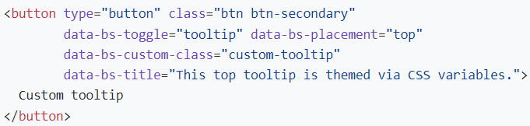
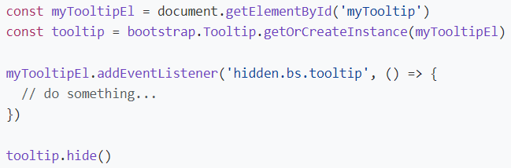







Tooltips
Custom tooltips
Directions
https://getbootstrap.com/docs/5.3/components/tooltips/

Slide 39
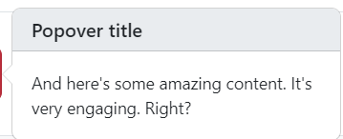


Popovers
Popovers are opt-in for performance reasons, so you must initialize them yourself.
Zero-length title and content values will never show a popover.
<button type="button" class="btn btn-lg btn-danger" data-bs-toggle="popover" data-bs-title="Popover title" data-bs-content="And here's some amazing content. It's very engaging. Right?">
Click to toggle popover
</button>
https://getbootstrap.com/docs/5.3/components/popovers/

Slide 40

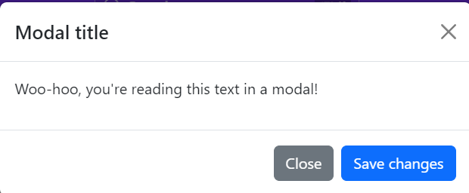
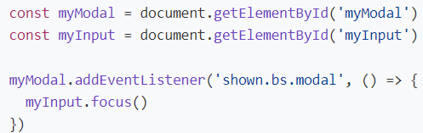
Modals
Clicking on the modal “backdrop” will automatically close the modal.
Bootstrap only supports one modal window at a time. Nested modals aren’t supported as we believe them to be poor user experiences.
https://getbootstrap.com/docs/5.3/components/modal/

Slide 41
Navbar, Navs & Tabs
Navbar:
A common UI component used to create a navigation menu at the top of a webpage.
Navs (Navigation):
Navigation elements used to create a set of links or navigation items within a webpage. They can be horizontal or vertical and are often placed within a Navbar or a sidebar.
Tabs:
Another type of navigation component that allows users to switch between different sections or views within a webpage, typically without having to navigate to a new page. Tabs are often displayed horizontally and consist of clickable labels or tabs that correspond to different content panels.

Slide 42
Navbar
Navbars are responsive by default, but you can easily modify them to change that. Responsive behavior depends on our Collapse JavaScript plugin.
https://getbootstrap.com/docs/5.3/components/navbar/

Slide 43

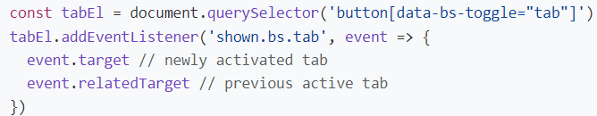

Navs & Tabs
Navigation available in Bootstrap share general markup and styles, from the base .nav class to the active and disabled states. Swap modifier classes to switch between each style.
https://getbootstrap.com/docs/5.3/components/navs-tabs/

Slide 44
Carousel
The carousel is a slideshow for cycling through a series of content, built with CSS 3D transforms and a bit of JavaScript. It works with a series of images, text, or custom markup. It also includes support for previous/next controls and indicators.
Carousels must be manually initialized using the carousel constructor method. Without initialization, some of the event listeners (specifically, the events needed touch/swipe support) will not be registered until a user has explicitly activated a control or indicator.

Slide 45
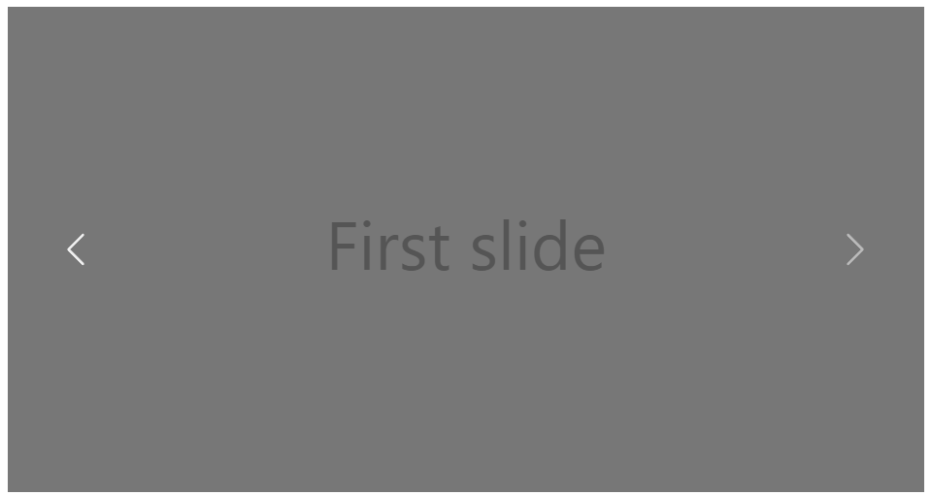
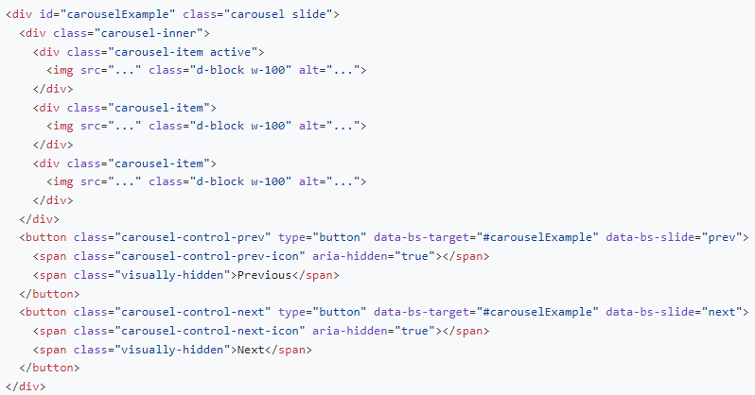
Carousel – cont’d
https://getbootstrap.com/docs/5.3/components/carousel/

Slide 46
Cards
A card is a flexible and extensible content container. It includes options for headers and footers, a wide variety of content, contextual background colors, and powerful display options. If you’re familiar with Bootstrap 3, cards replace our old panels, wells, and thumbnails. Similar functionality to those components is available as modifier classes for cards.

Slide 47
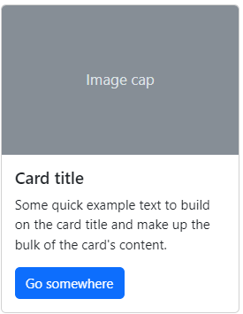
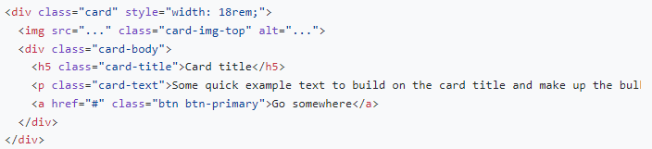
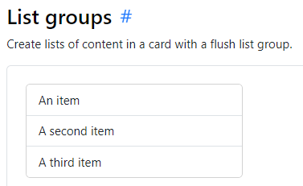
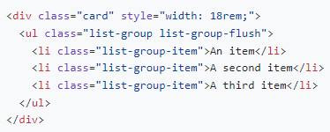
Cards – cont’d
https://getbootstrap.com/docs/5.3/components/card/

Slide 48
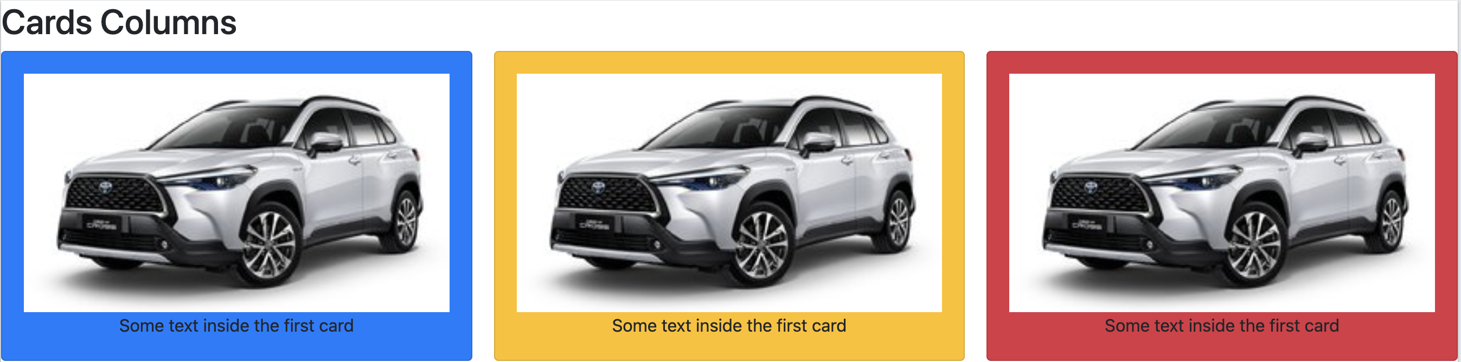
Exercise 7: Demo about Cards Column

Slide 49
Bootstrap Forms

Slide 50
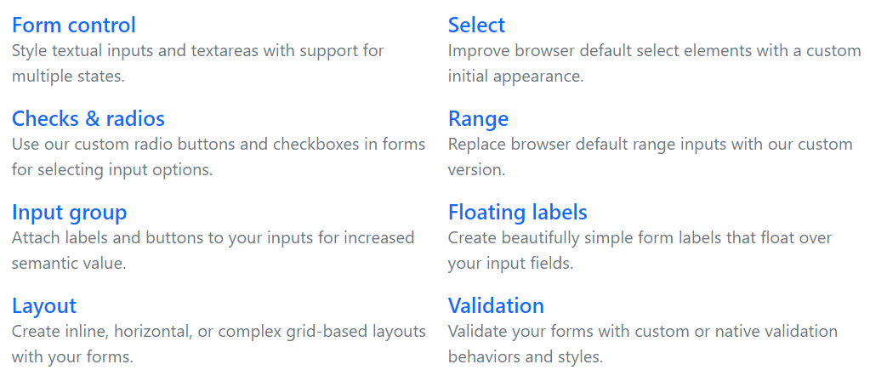
Bootstrap ‘s form controls
Bootstrap’s form controls expand on our Rebooted form styles with classes. Use these classes to opt into their customized displays for a more consistent rendering across browsers and devices.
https://getbootstrap.com/docs/5.3/forms/overview/

Slide 51
Exercise 8: Demo about Form Controls

Slide 54
Lab 2: Build the website interface

Slide 55
Summary
Concepts were introduced:
Identify the purpose of using front-end UI frameworks in web design and development
Set up and Configure project with Bootstrap
Use the Bootstrap grid system to design responsive websites
Recognize how the JavaScript components provide dynamic behavior
Create various navigational elements using Tabs and Accordion
Create modals, tooltips and popovers to reveal content in your website
Build a carousel to show dynamic content on your website

